Slide 1
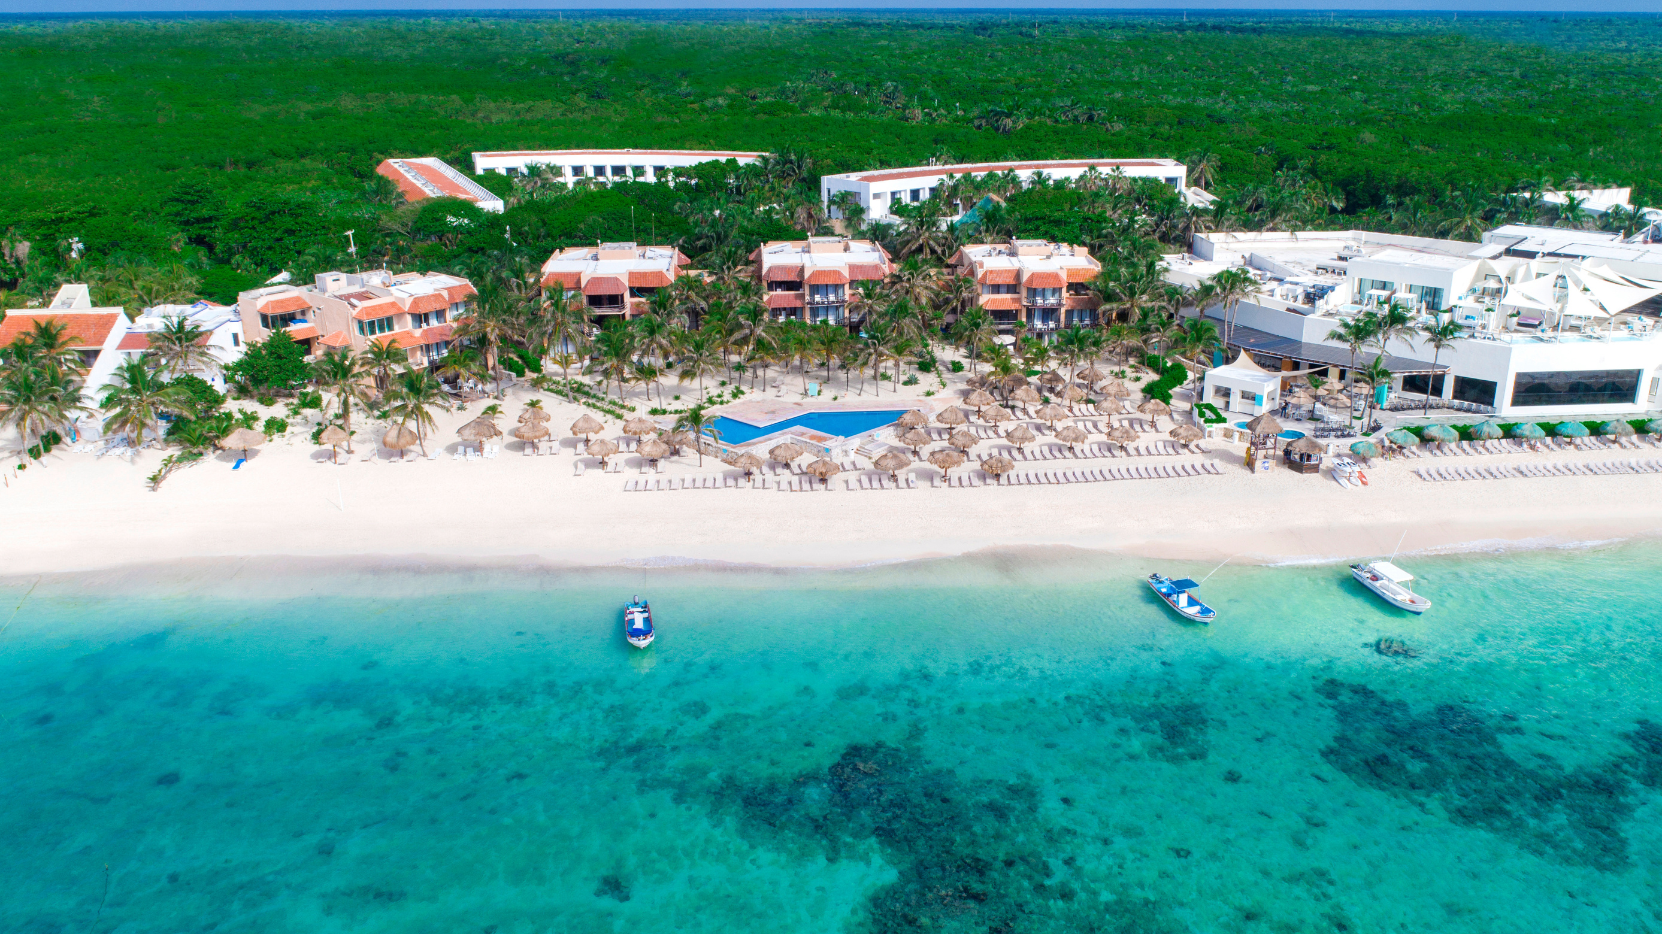
GRAND OASIS TULUM
-THE CALM RESORT-
CANCUN MEXICO

Slide 2
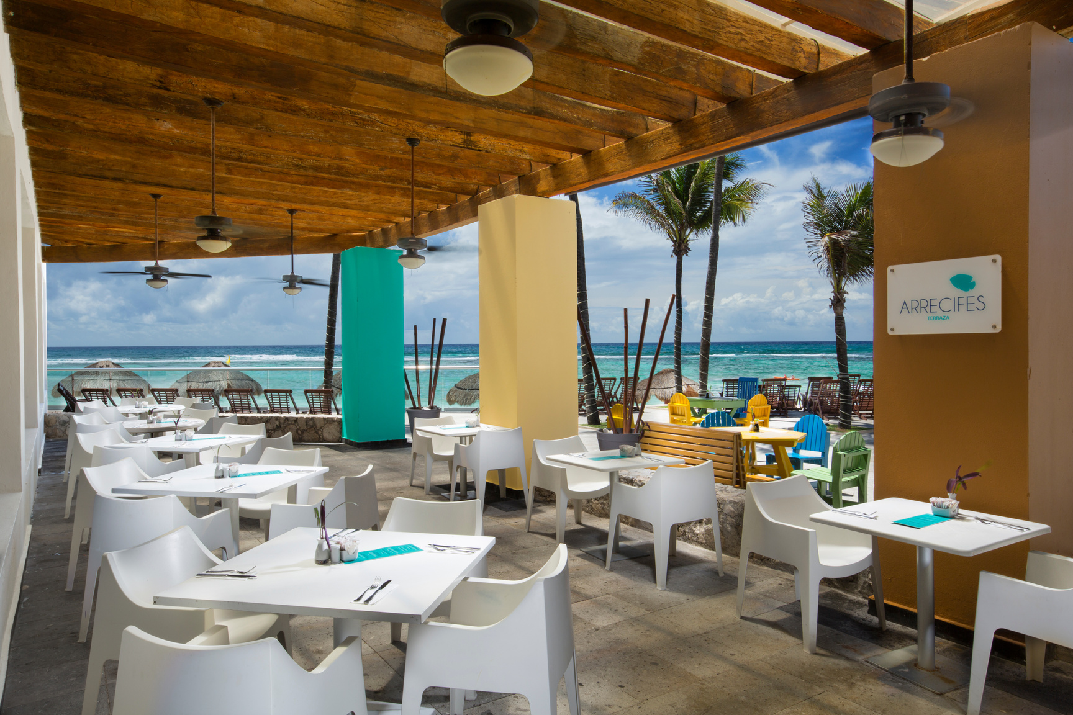
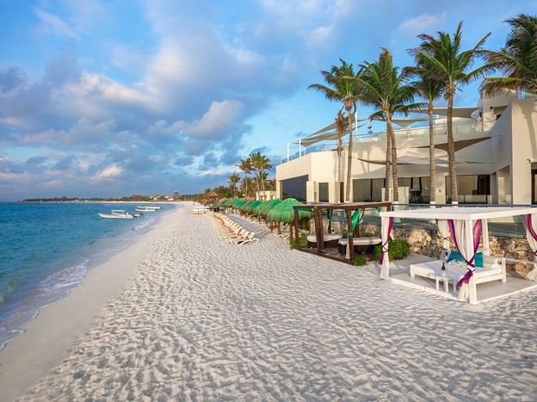
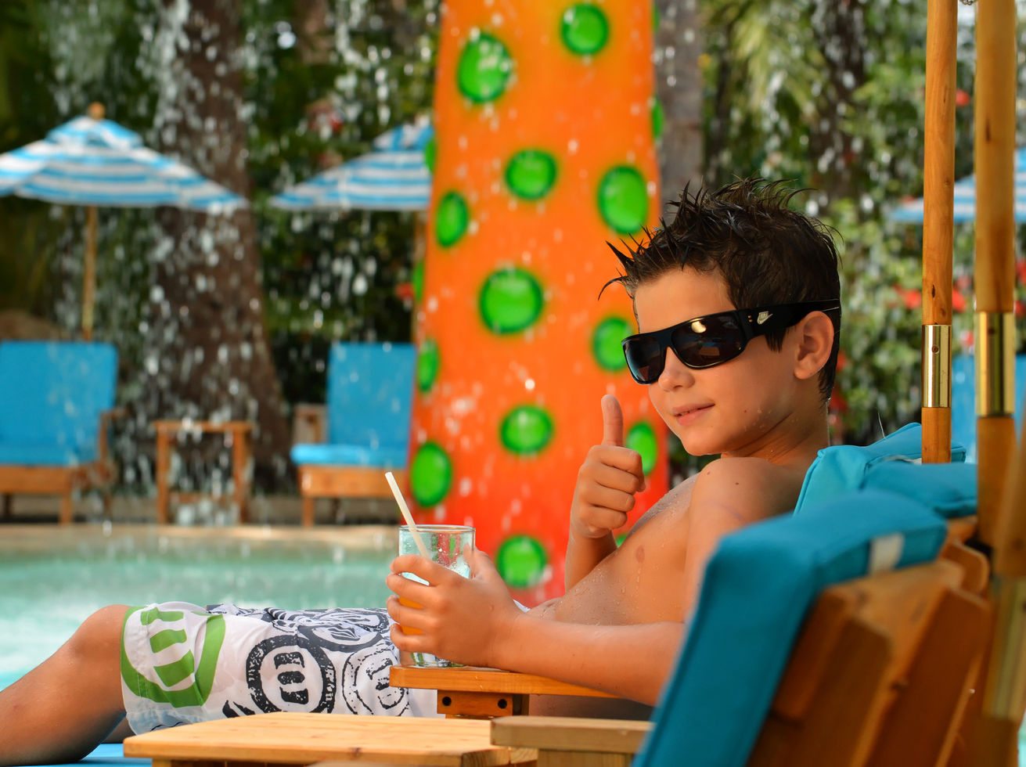
HIGHLIGHTS
All-inclusive resort amid nature.
Suites and rooms with ocean views.
Suites and rooms with space for families of up to 2 adults and 3 children.
Gastronomic variety with specialty restaurants, fusion cuisine, a la carte dishes, and snacks by the sea.
KiddO Zone: children entertainment spaces.
Nautical activities.
Complimentary Grand Oasis Runaway at Grand Oasis Cancun (transportation not included).

Slide 3
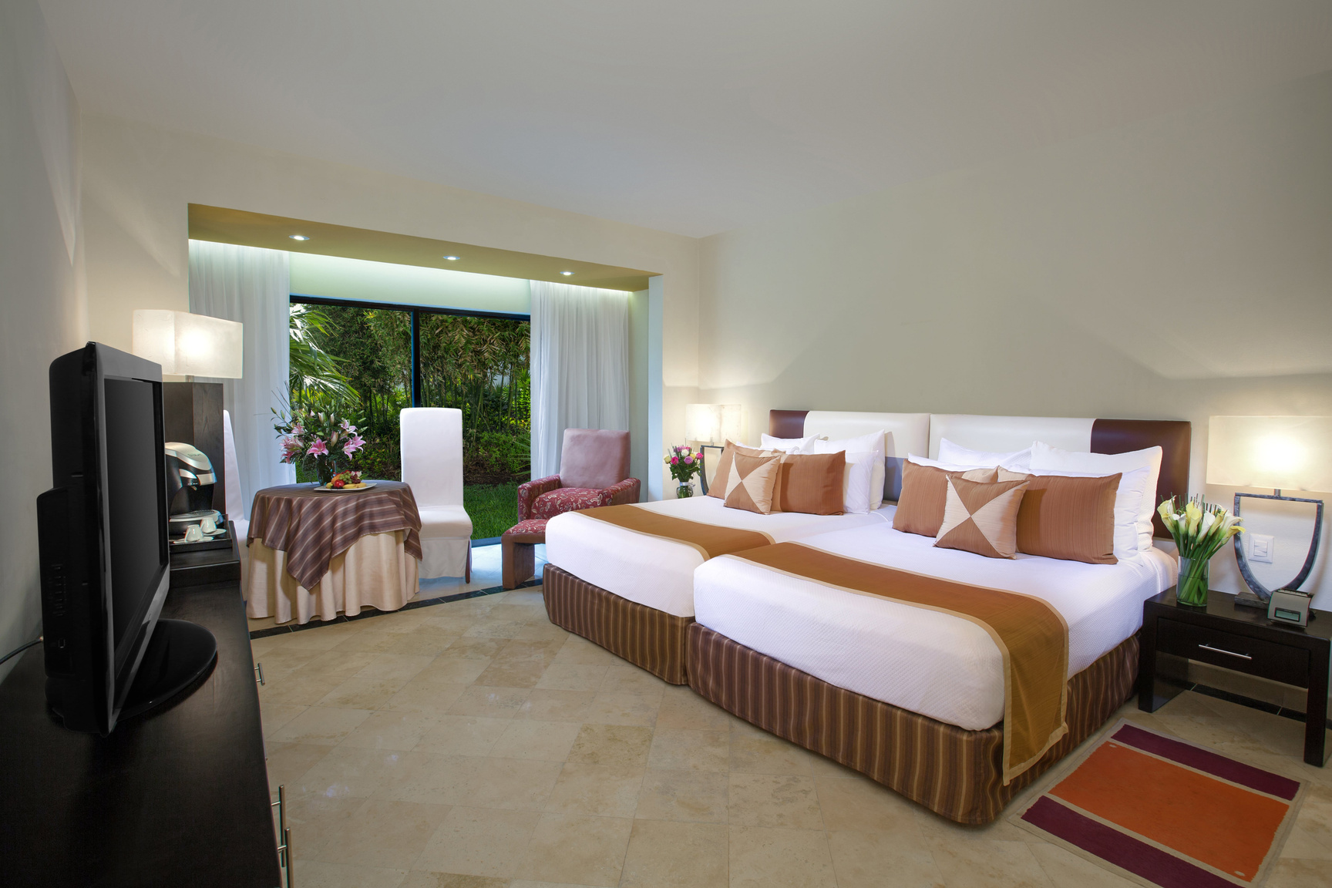
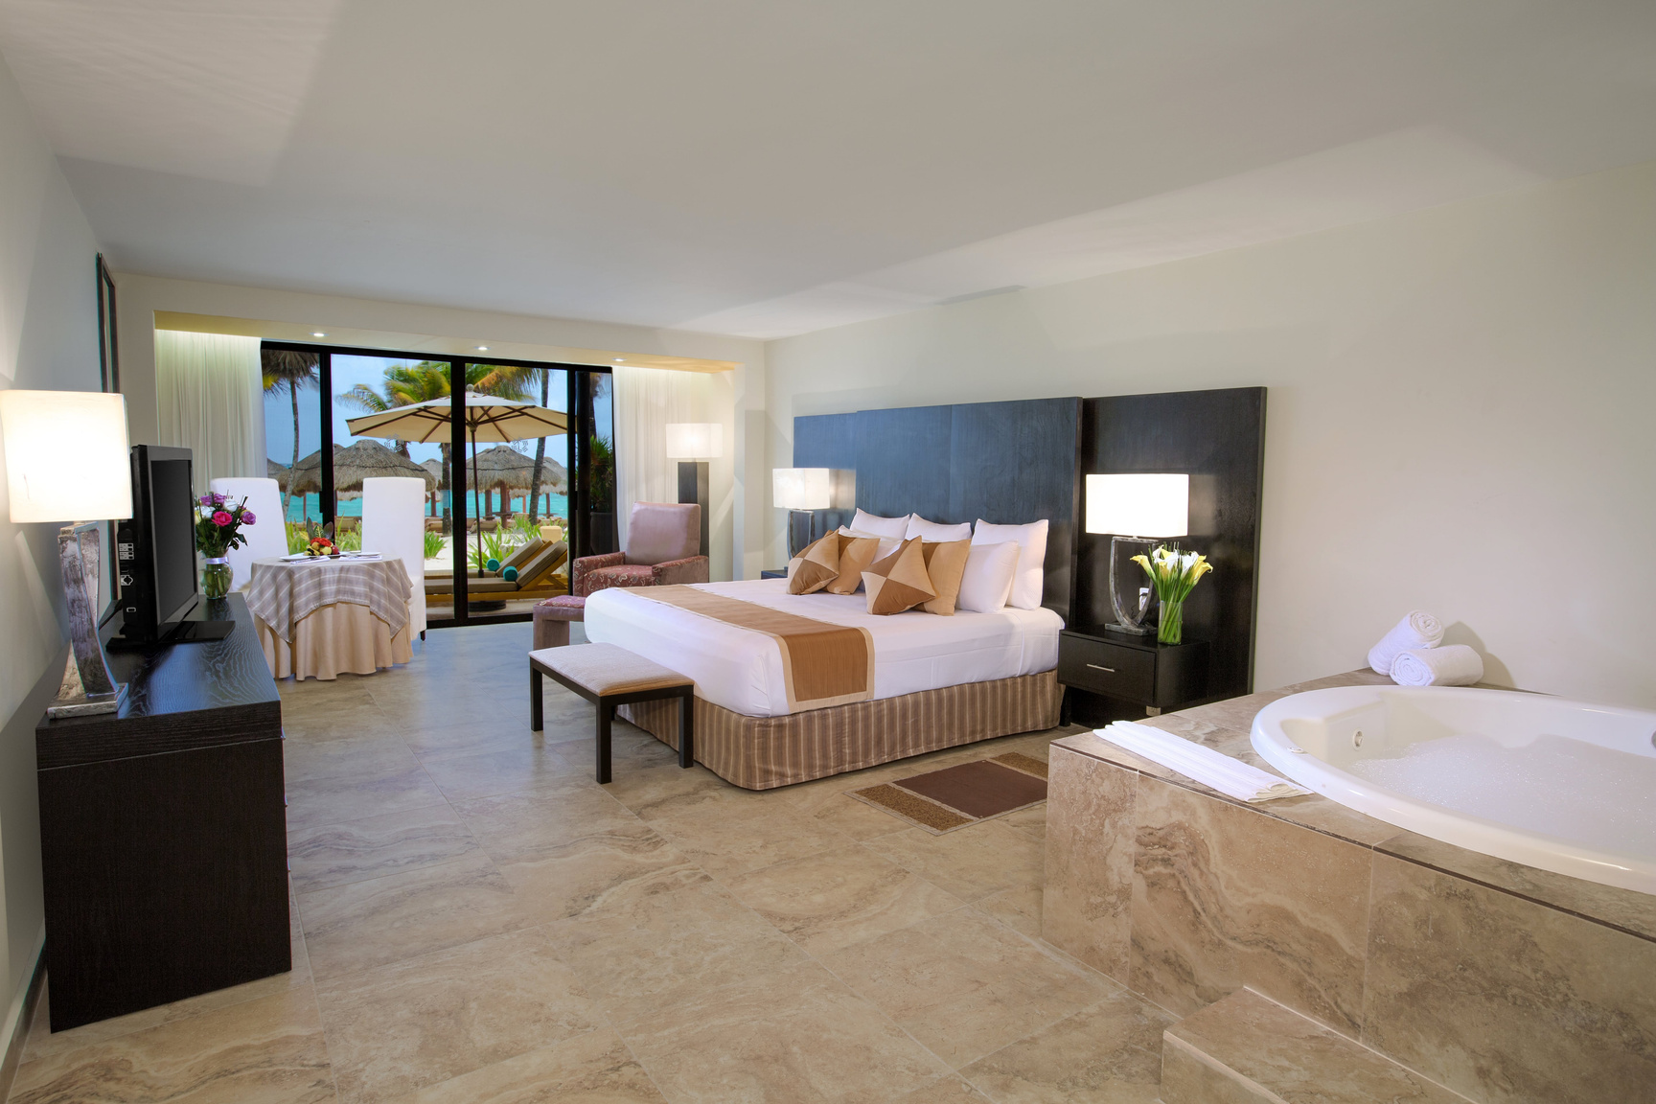
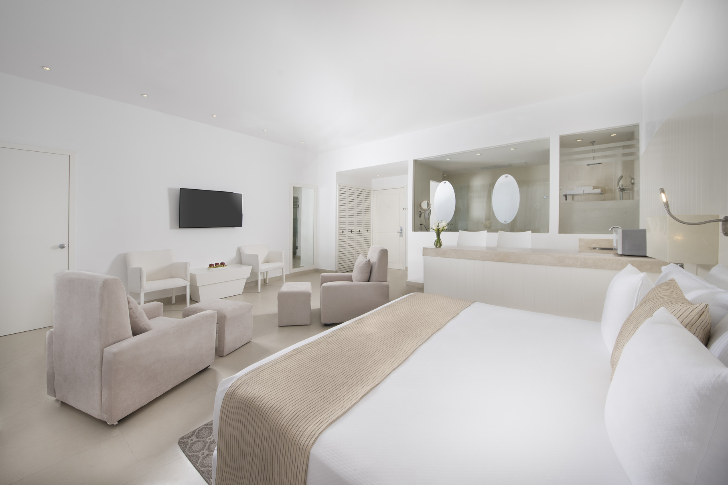
All Rooms Feature
King Size or Two Double Beds
Minibar: cool drinks, beer and water
Coffee machine
Air conditioning
Bath amenities and beach towels
USB ports
Iron and Ironing board
Flat screen TV
Ipod console and alarm clock radio
WIFI
Safety box
*Junior Suite has an in room jacuzzi
*Family Suite is guaranteed 2 interconnecting rooms
Junior Suite Beach Front
Standard
Family Suite

Slide 4
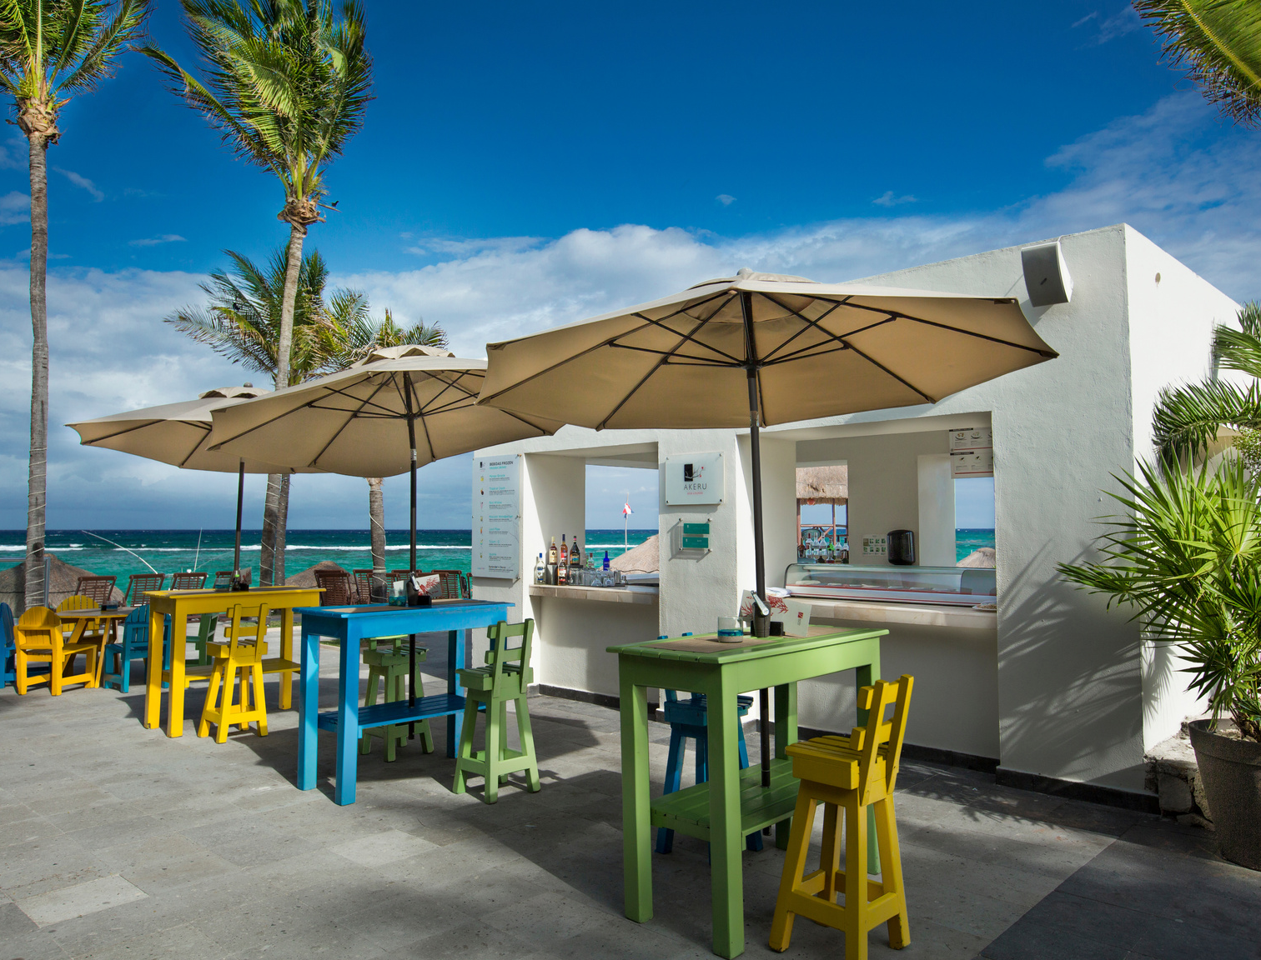
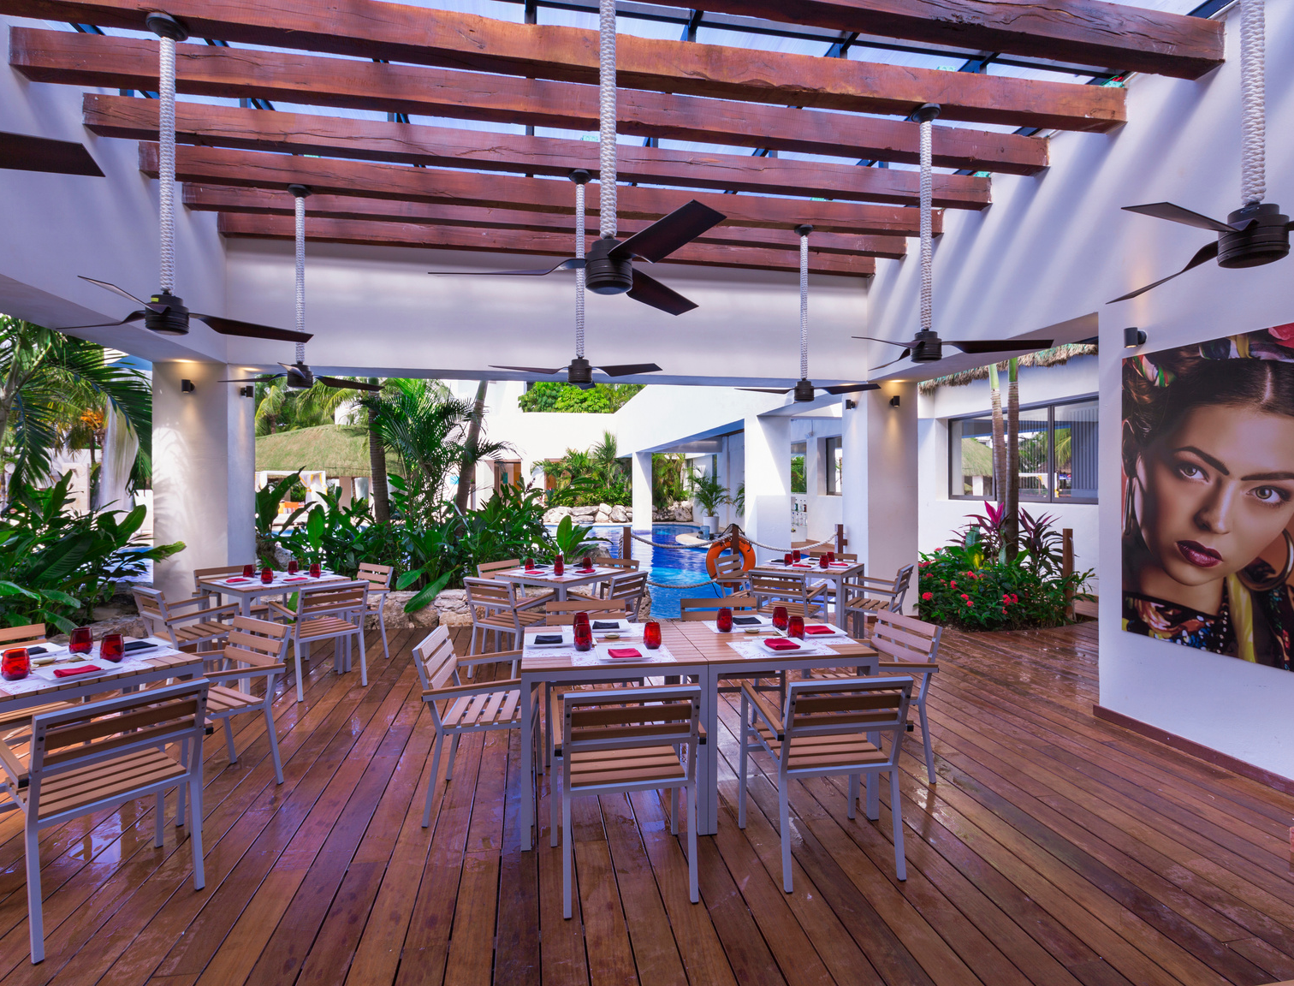
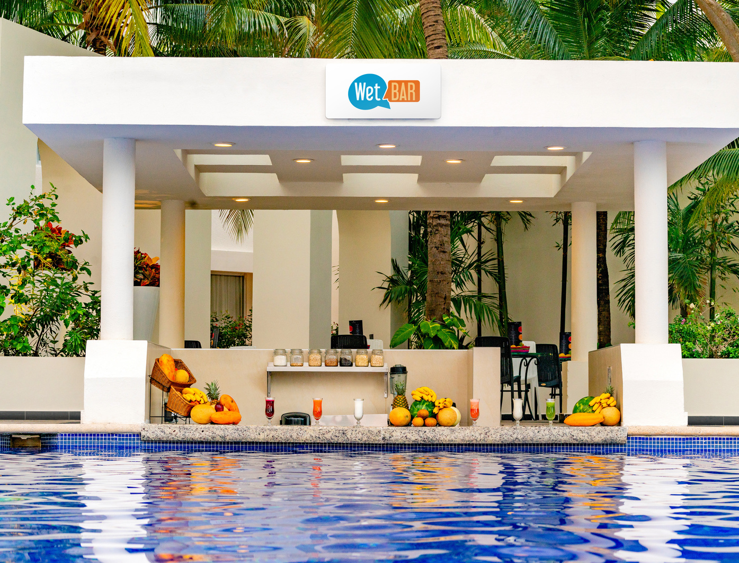
Restaurants & Bars
MAKI TACO - Japanese-Mexican Fusion
DOS LUNAS - Italian
ARRECIFES BUFFET - International Buffet
ARRECIFES TERRAZA- Snack Bar Terrace
HIPPIE CHIC GRILL - Grill, tacos, & tortas
HACIENDA SARAPE - Mexican
LE PETIT CHEF - Sensory Gastronomy *
COFFEE & ME - Coffee shop
ARRECIFIES BEACH BAR
LAS PALMAS BAR
SCRAPE BAR
LA CANTINA
*Additional Cost

Slide 5
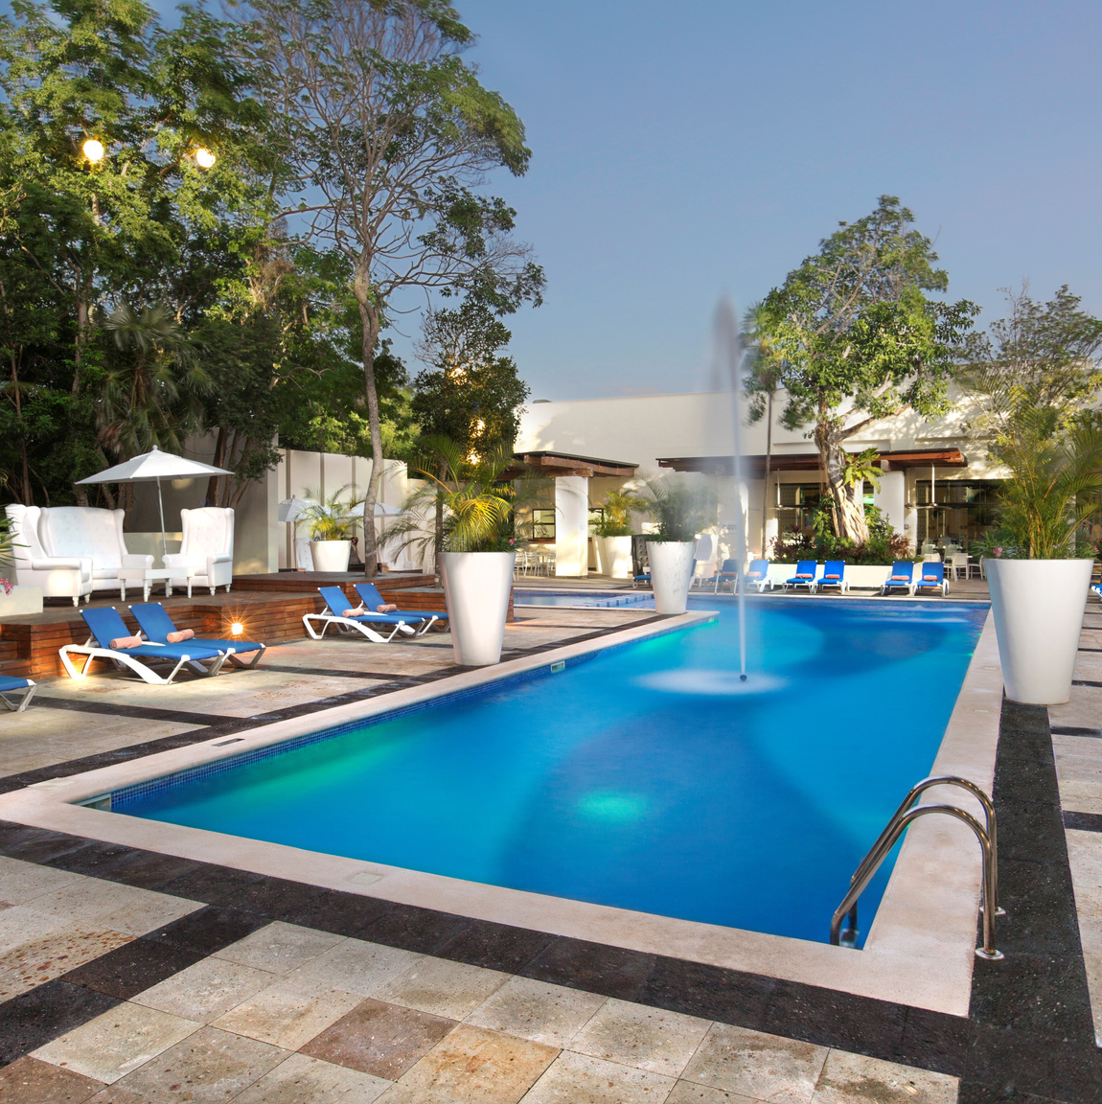
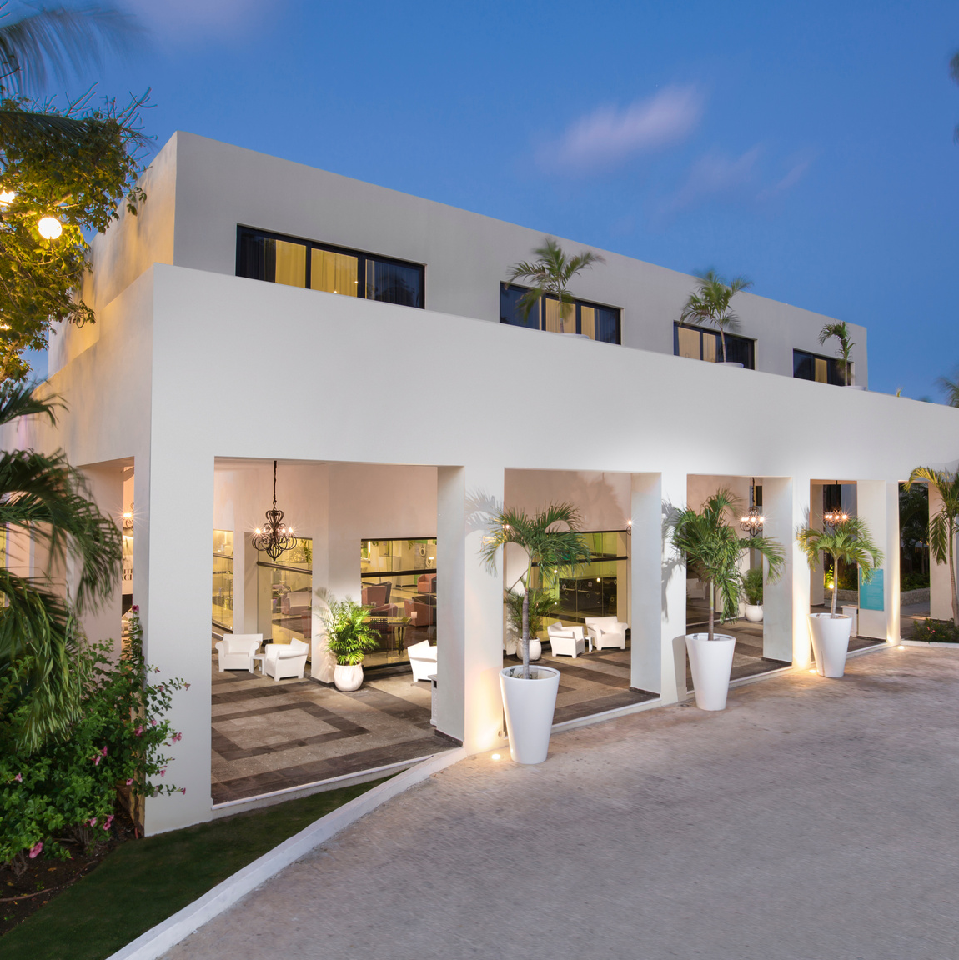
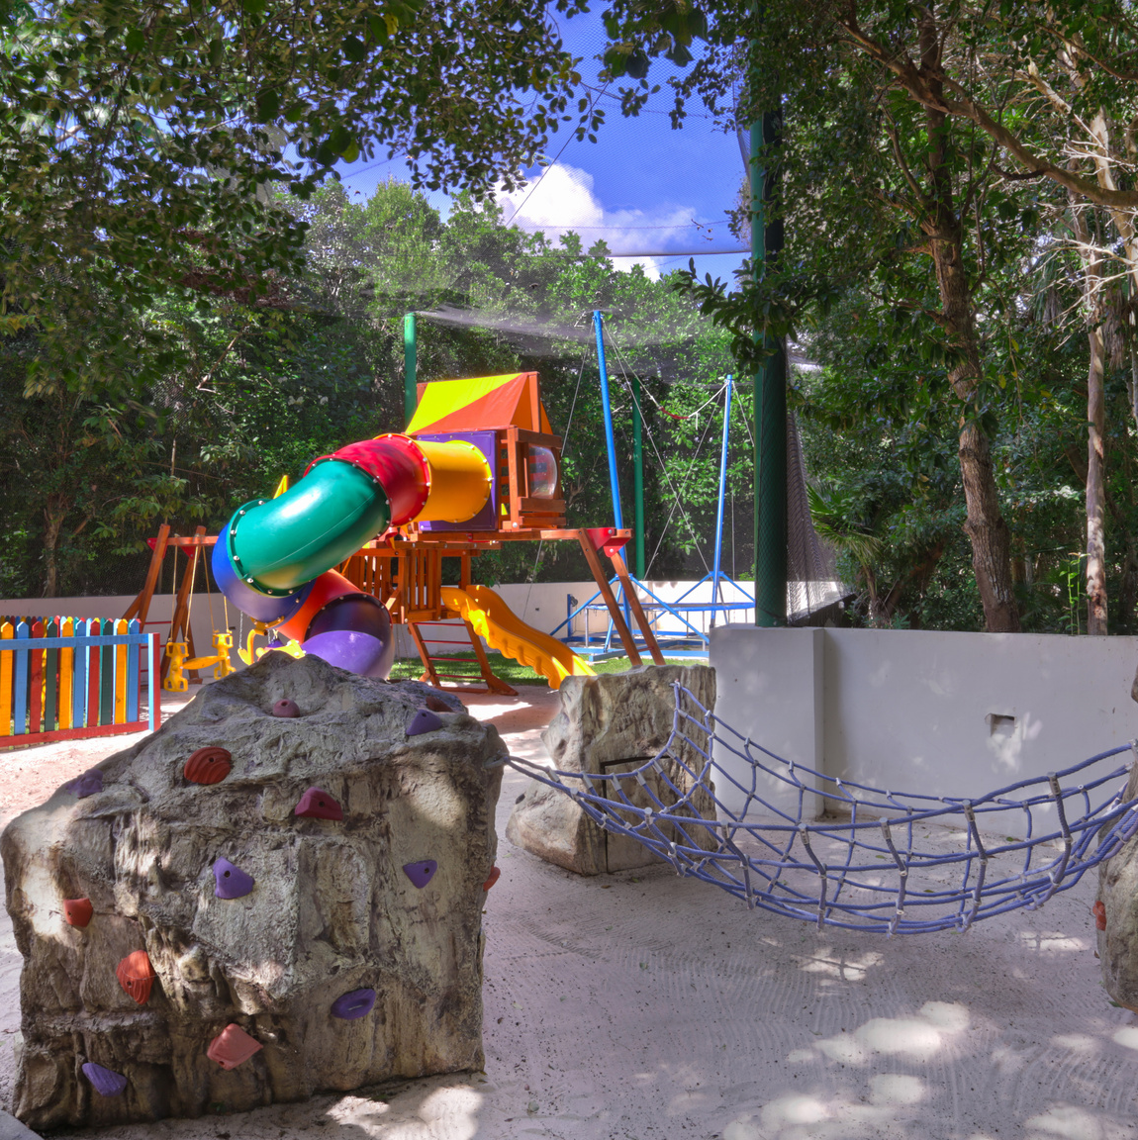
KiddO Zone at Grand Oasis Tulum
With the intention of enhancing family time, Grand Oasis Tulum presents the Family Club KiddO Zone area; a space of fun especially created for families to spend the most unforgettable moments together.
One of this area’s main features are the convenient Family Suites, made up of two communicating rooms, which allow the group to stay together without losing privacy.
Beyond these special suites, at the Family Club KiddO Zone, the little ones will be excited with the playground and children entertainment, stations with food, beverages, and snacks, in addition to a family pool.

Slide 6
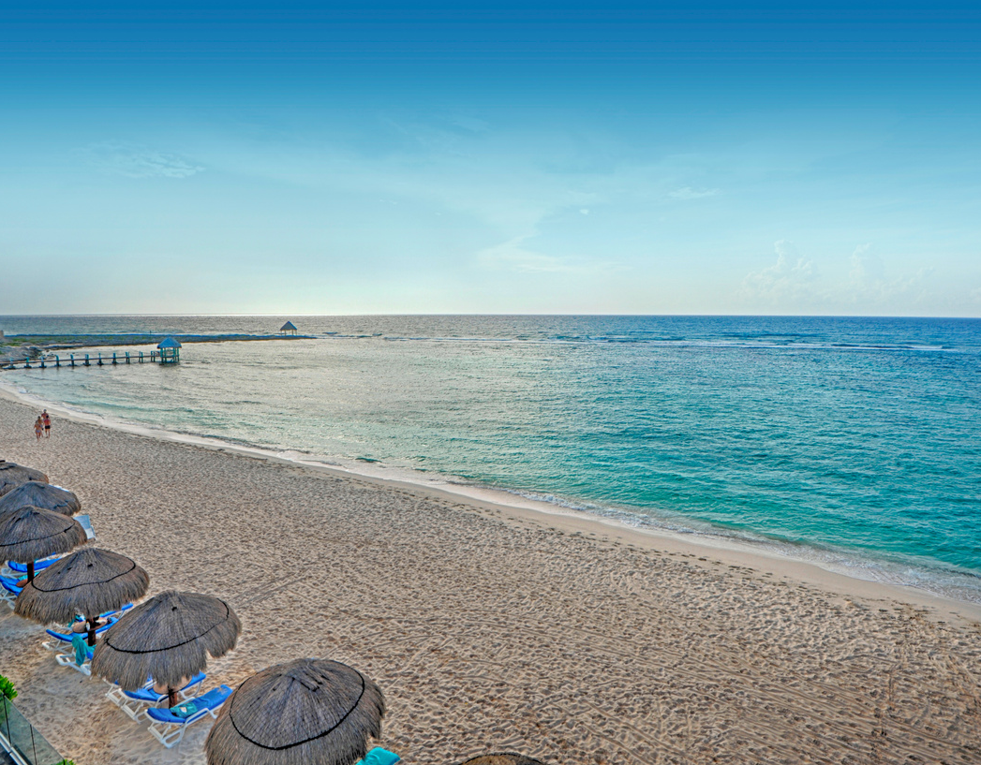
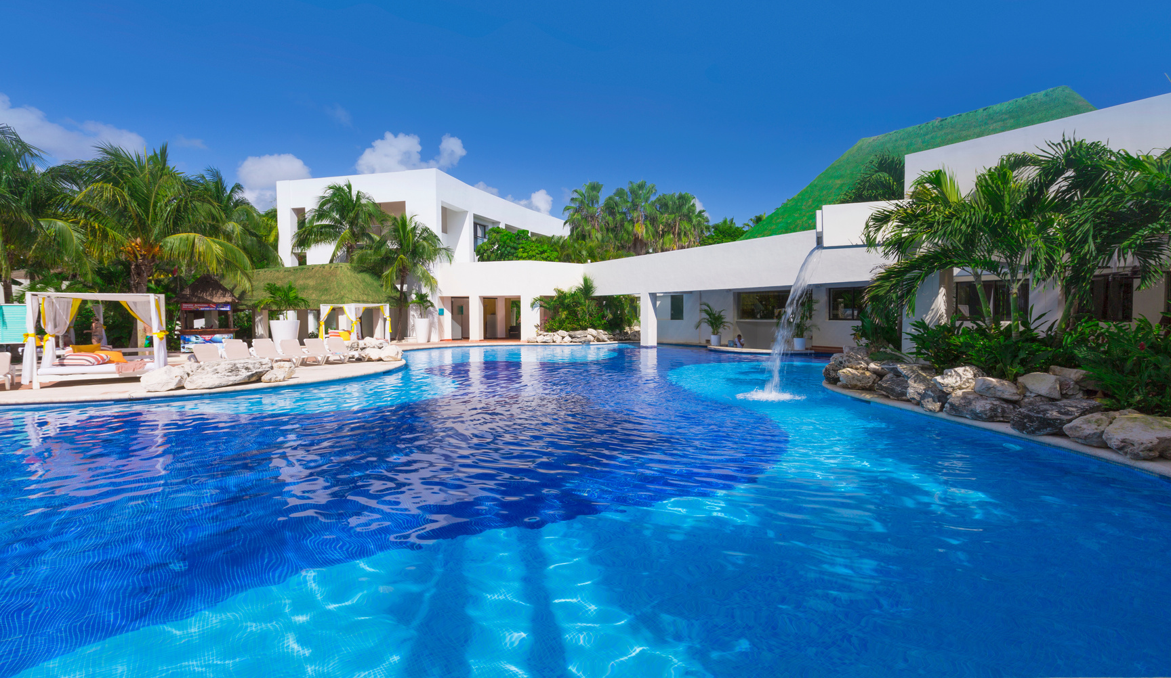
Snorkelling
Paddle Boarding
Kayaking
Gym
Tennis Courts (with rackets and balls)
Multiuse Court
Day and Night Entertainment
Boutique
Fishing and Diving activities (at extra cost)

Slide 7
